Slide 1
Factory Method
Lecture 17

Slide 2
Factory Method
Factory pattern is one of the most used design patterns in Java. This type of design pattern comes under creational pattern as this pattern provides one of the best ways to create an object.
In Factory pattern, we create object without exposing the creation logic to the client and refer to newly created object using a common interface.

Slide 3
Intent
Factory Method is a creational design pattern that provides an interface for creating objects in a superclass, but allows subclasses to alter the type of objects that will be created.

Slide 4
Problem
Imagine that you’re creating a logistics management application. The first version of your app can only handle transportation by trucks, so the bulk of your code lives inside the Truck class.
After a while, your app becomes pretty popular. Each day you receive dozens of requests from sea transportation companies to incorporate sea logistics into the app.

Slide 5
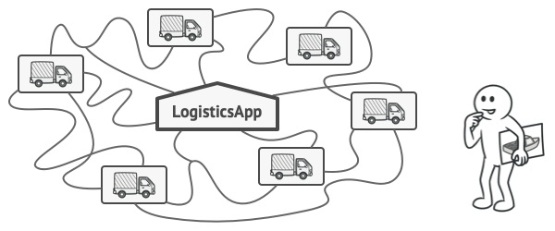

Slide 6
At present, most of your code is coupled to the Truck class.
Adding Ships into the app would require making changes to the entire codebase. Moreover, if later you decide to add another type of transportation to the app, you will probably need to make all of these changes again.

Slide 7
Solution
The Factory Method pattern suggests that you replace direct object construction calls (using the new operator) with calls to a special factory method.
The objects are still created via the new operator, but it’s being called from within the factory method.
Objects returned by a factory method are often referred to as products.

Slide 8
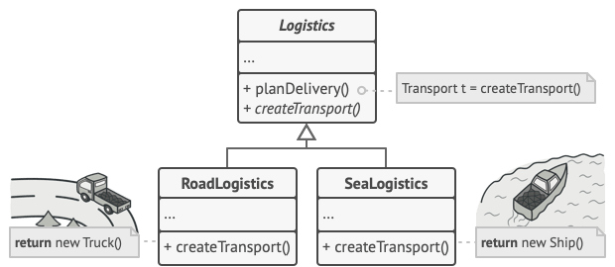

Slide 9
Advantages
At first glance, this change may look pointless: we just moved the constructor call from one part of the program to another. However, consider this: now you can override the factory method in a subclass and change the class of products being created by the method.

Slide 10
Limitation
There’s a slight limitation though: subclasses may return different types of products only if these products have a common base class or interface. Also, the factory method in the base class should have its return type declared as this interface.

Slide 11
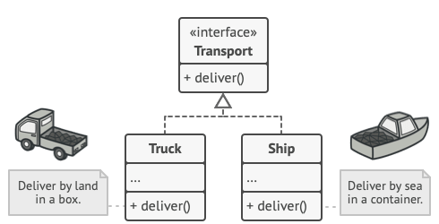

Slide 12
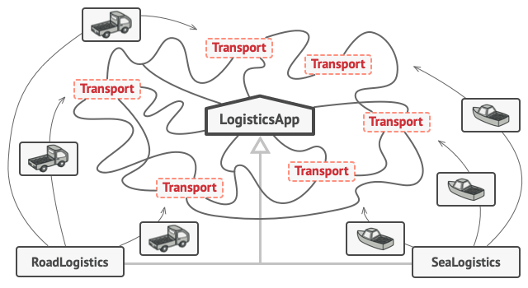

Slide 13
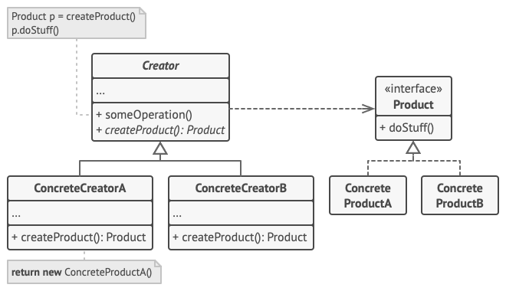

Slide 14
Example
FactoryPatternDemo, our demo class will use ShapeFactory to get a Shape object. It will pass information (CIRCLE / RECTANGLE / SQUARE) to ShapeFactory to get the type of object it needs.

Slide 15
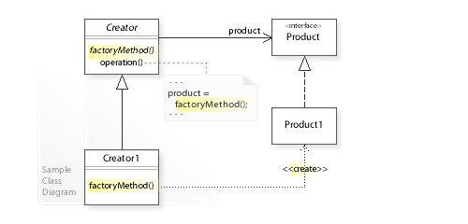

Slide 16
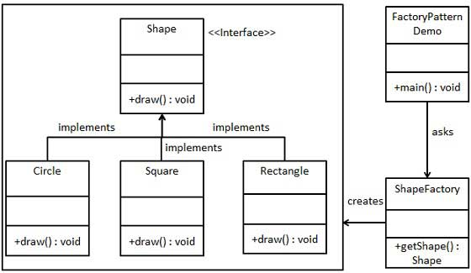

Slide 17
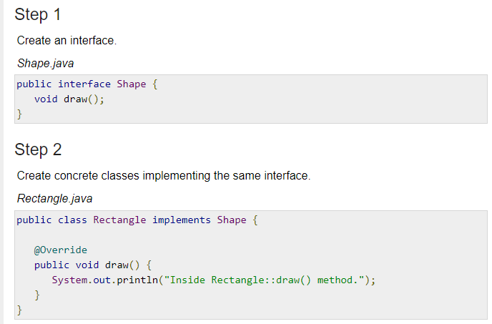

Slide 18
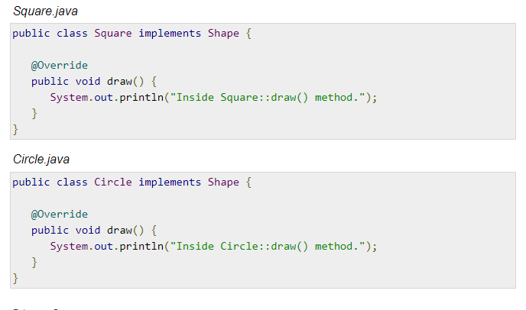

Slide 19
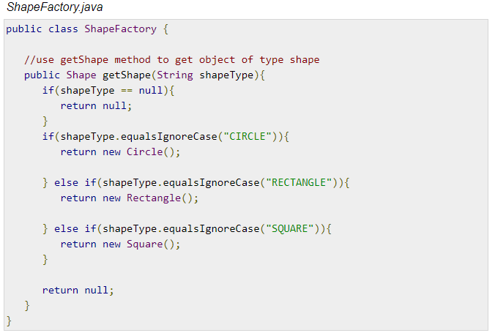

Slide 20
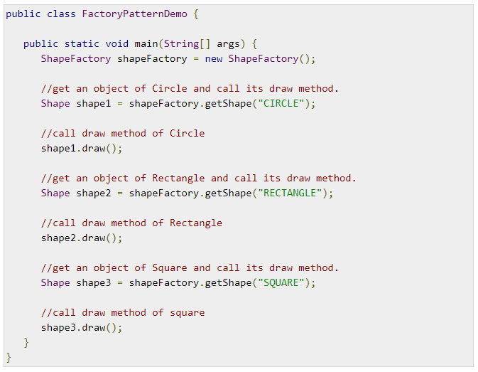

Slide 21
References
https://refactoring.guru/design-patterns/factory-method
https://en.wikipedia.org/wiki/Factory_method_pattern
https://www.tutorialspoint.com/design_pattern/factory_pattern.htm

